Slide 1
Water Main Break Prediction Model
Presented By:
Roy Brander & Joanna Line
Notes:
Good day, we are Joanna Line, Infrastructure Engineer for Water Resources, City of Calgary, who manages the waterworks linear infrastructure; and her predecessor, Roy Brander. We weren’t sure who’d be delivering which slides, so the whole thing is written in third person. Just pretend I’m somebody else entirely. This model came from Roy’s 20-years of watching the water system, and gathering data on it. It appears to predict successfully, and so it’s now used to select mains for replacement or rehabilitation in just days each year, when it used to take many weeks. We suspect that any city can follow our basic steps to develop an equivalent model of their own, and largely automate the selection of optimal capital programs.

Slide 2
Agenda
2012 Model Build
Real World Testing
2015 Model Review
Notes:
We’ll be going over how the model was developed in 2012 with the forty years of main break data. It needs only the break data up to a given year to predict where breaks will happen in the next. Then we’ll show how the predictions stacked up against the actual break counts for the last dozen years of breaks. And lastly, we’ll go over how Joanna repeated the whole development, so that she could own the process. She’ll need to update it every several years.

Slide 3
2012 Model Build
Materials, Diameters and Corrosion, oh my!
Notes:
In 2012, Roy basically broke the water system pipe inventory into statistical bins as small as possible, and looked for correlations between past breaks and the next year’s.

Slide 4
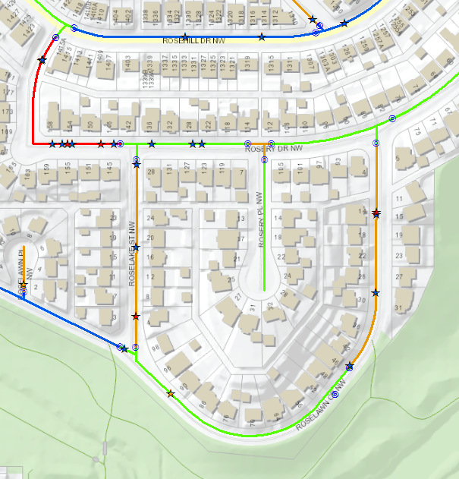
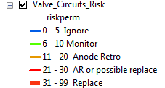

Standard Replacement Limits
The “Unit of Work” is the Valve Circuit: The segments of main you can turn off with valves
The unit of customers affected by a repair; also the unit of replacement
Model based on count of recent breaks that have happened to the valve circuit
Studied 8652 metallic valve circuits across 1972-2011: a statistical set of 335,392 “Valve-circuit-years”
Notes:
The first question we have to answer before predicting which mains are the worst is what we mean by “main”. Do we chop the system up by block, or into chunks exactly 100m long, or what? A valve-circuit is the smallest portion of the network we can put out of water by walking around it and turning all the valves nearest the site we have to dig to repair. Valve circuits are both the portion of system that is out of water for a break repair, AND the portion of system we normally replace: valve to valve.
There are just under 9,000 metallic valve circuits of reasonable length to use as test cases. If you assume that just the last 5 years of breaks can predict the next year, you can ask that question about one valve circuit 35 times with 40 years of data: did the breaks from 1972-1976 predict 1977? Then, did 1973-1977 predict 1978? Did 1982-1986 predict 1987? You can repeat the question every year. So less than 9000 valve circuits gave us over 300,000 “valve-circuit-years” of statistical cases.

Slide 5
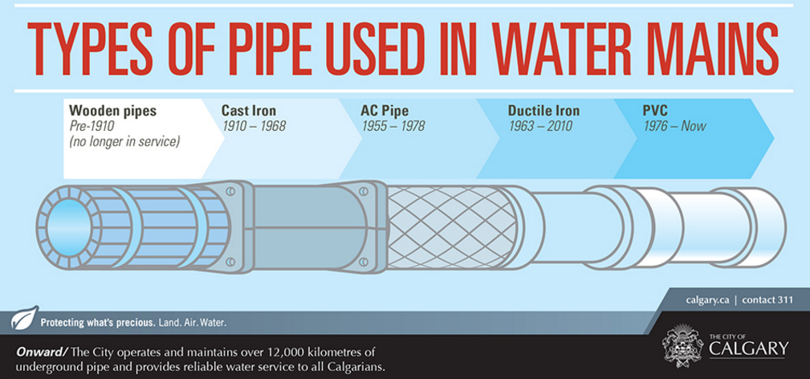
Risk Groups
Cohort Groupings by Three Dimensions
  Material : CI (2), DI (2), non-metal (2)
  Diameter: 100-200, 250-400
  Corrosion : Copper Services? Soil?
Notes:
With over 300,000 entries in the total database, we could still get statistically large numbers for each group even by breaking the inventory up into many groupings. We broke it up into six material groups, each of those into two diameter groups, and most of those into three groups by corrosion risk. We sliced, then we diced, and then we chopped up the dice into threes.

Slide 6
Material Cohorts - metres
Notes:
Incidentally, this model not only excludes feedermains by just giving them all one very low probability of break, it does the same with all the plastic, which is half our system, and the “Other” materials like AC and concrete; the statistics are all for our four kinds of iron pipe: pit and spun cast iron, regular Ductile and our heavily coated and anode-protected Yellow-Jacketed Ductile Iron, the YDI.

Slide 7
Material Cohorts
Notes:
Break probability is very, very affected by breaks the valve circuit had in the previous five years, it goes RIGHT up from 0 to 1 to 2+ on the X-axis. But it is also distinctly different for the three materials. And that, unless you want to get into the weeds, can be expanded with a hand-wave to say "similar graphs can be done, within Thick-Wall CI, say, for different diameters, or different corrosion groups".

Slide 8
Material Cohorts
Notes:
This chart of breaks over time makes it plain why the different materials are separate risk groups: it lumps together both kinds of CI, but you can see where YDI has less than half the breaks of regular DI, though DI breaks have come down sharply from a lot of cathodic protection, and even the CI breaks are down from heavy replacement. But the green line of breaks on “other” can be neglected.

Slide 9
Diameter Cohort
Notes:
Rather than tracking the yearly figures, this chart makes breaking out the diameter probabilities even more clear: the total breaks over 5 years, averaged down to breaks per 100km per year, just for iron mains – breaks go down with every increase in diameter, though it’s most startling at the transition from 150 to 200mm. Another look at the model might not lump 150mm and 200mm together as Roy did in 2012.

Slide 10
Diameter Cohort
Larger diameters have thicker pipe walls and take longer to develop holes
Very few breaks on our very large pipe
0 to 200 mm 250 to 400 mm
Notes:
But, it seemed reasonable at the time: the statistical “bins” started getting too small with more than two diameter ranges grouped, so just 0-200 mm and 250-400 were used. All feedermains were excluded from this model; they are completely separate animals again and their huge costs justify a more manual evaluation approach so far.

Slide 11
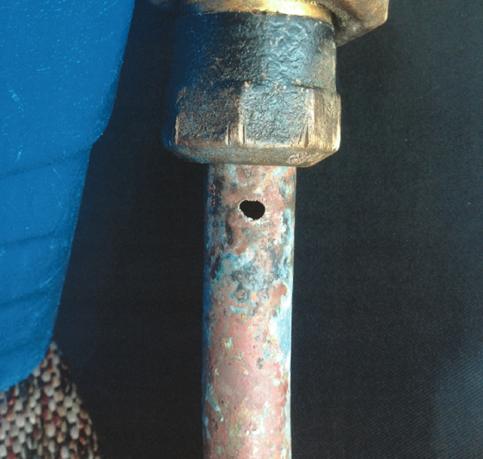
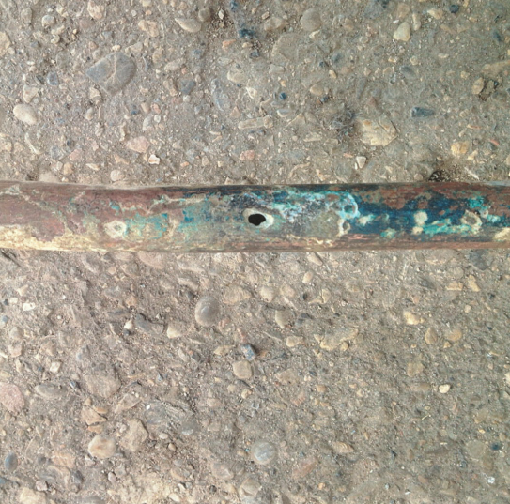
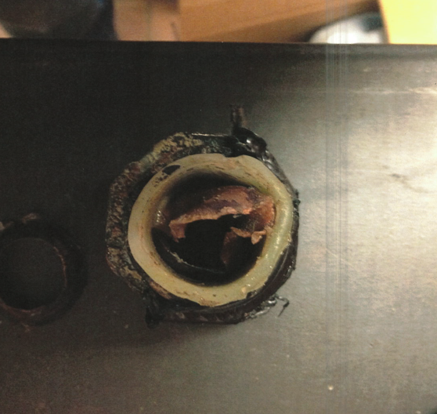
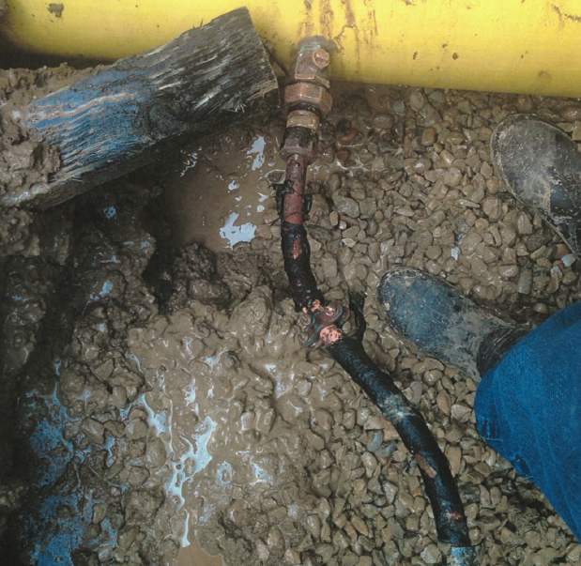
Corrosion Cohort
Notes:
After slicing by material and dicing those by diameter group, we segmented those bins in turn using data we had on how likely they were to be corroded by their environment.
Copper services promote corrosion in iron until we learned to isolate them after 1978 – and low resistivity soils enhance that “corrosion cell” where the two metals contact as shown in these photos from actual Calgary repairs. Especially in the low-resistivity soils, like black dirt which is full of sulphates, you can see how pitting in iron increases dramatically near the point where copper services go into the pipe.

Slide 12
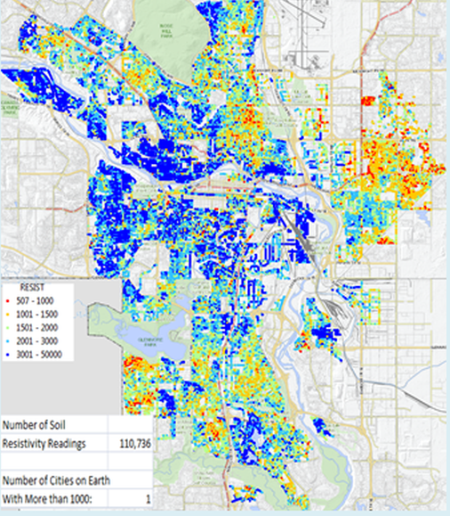
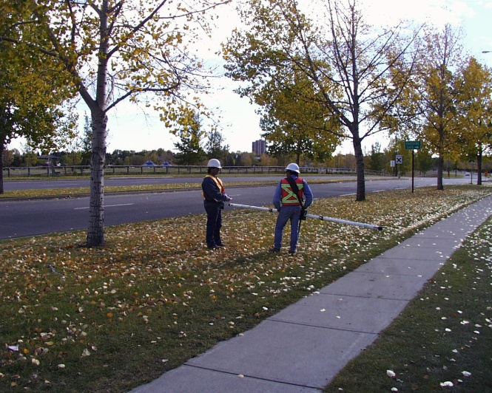
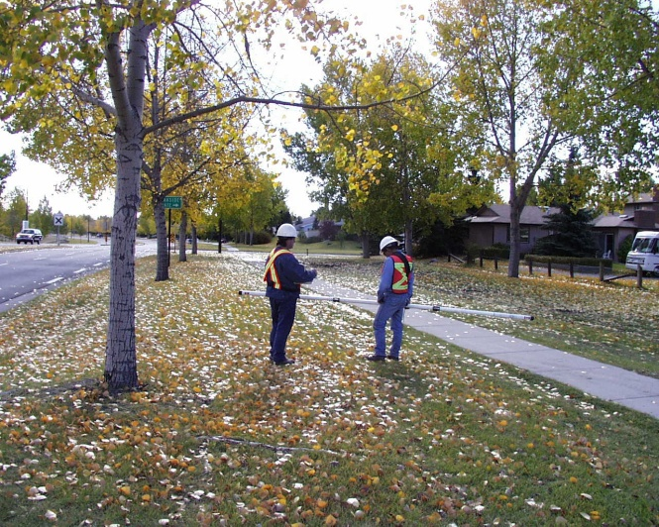
Corrosion Cohort
Notes:
In the early nineties, the corrosion technicians tested out the Geonics soil resistivity meter, which can pick up a resistivity without even touching the dirt: an antenna just pulses an electromagnetic wave through the ground underfoot and gives you the resistivity in a second. So Roy had them walk the streets of all the metallic mains and take a reading at every house – finally over 110,000 of them across 9 years, allowing us to map the city by how “hot” the soils were. This map uses the spectrum as a color range, with the least-corrosive soils, the gravels along the rivers, in blue, and the hottest black-dirt soils of the northeast, in orange and red. The model simplifies it down to “high” or “low” resistivity for a whole block.

Slide 13
Corrosion Cohort
NoServ : No Copper Services
(unless isolated, after 1978)
ServLow : Copper Services and
Low Soil Resistivity (corrosive)
ServHi : Copper Services, High Resistivity
NA : Plastic or Cement Material
Notes:
In the database, every valve circuit was given one of four values for this variable. We believed that if a pipe had no copper services at all – the side streets, mainly - then it didn’t matter what the soil resistivity is – but if it had copper, then it had to be broken into one of two groups, high or low soil resistivity. And all the AC and Plastic mains were just given an “NA” on this one.

Slide 14
Material/Diameter: Length vs Breaks
 |  |  | Diameter Group
 | Material | Data | 100-200 | 250-400 | Total
 | DI | % Breaks | 17% | 12% | 29%
 |  | % Length | 21% | 15% | 37%
 | PIT | % Breaks | 25% | 4% | 29%
 |  | % Length | 22% | 7% | 29%
 | SPUN | % Breaks | 34% | 8% | 42%
 |  | % Length | 26% | 9% | 35%
 | Total % Breaks |  | 76% | 24% | 100%
 | Total % Length |  | 69% | 31% | 100%
Notes:
A chart that broke down all six materials, two diameter ranges, and four corrosion-risk choices into some forty groupings would be unreadable. But we can give you the idea with a simpler breakdown into six groupings: Three material types, Thicker Pit-Cast and Thinner Spun-Cast Iron, then Ductile, thinnest; and the two diameter groupings. Taking that as a system, here’s how they break down for both contribution to total length and contribution to total main breaks for the five years 2009 to 2013. Pit-Cast is exactly pulling it’s weight: 29% of the system and 29% of the breaks. But the larger-diameter pit cast is only doing half the pulling: 4% of the breaks on 7% of the system. Small-diameter spun-cast, on the other hand, at 34 to 26, is doing a third more than its share of having breaks. This is the kind of segmentation that went down a few more levels.

Slide 15
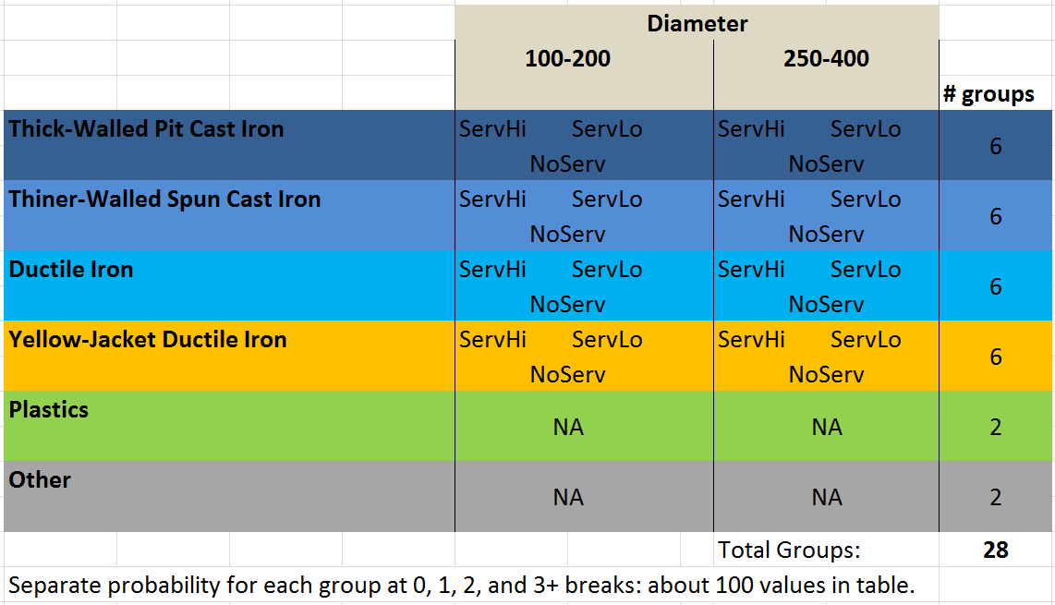
Final Risk Groups
Notes:
If I don’t try to show numbers, I can break out all the groups in what we use as their standard map colours – lighter and lighter shades of blue for iron with thinner walls, yellow for the YDI of course, green for PVC, grey for other. Then the columns break out the diameters, and each cell has three corrosion groups for metal and just NA for non-metal. All told, 28 statistical. In total, probability table has about 100 values. We had to fill them in from that 40-year history of breaks.

Slide 16
The Influencing Period
Notes:
Roy made the assumption that you only needed the last 5 years of breaks to predict from experience. But this chart gives the assumption support. It separates out old from new breaks by graphing the total of breaks more than seven years old, against the average breaks summed up for the last 3 years – old vs new. And they have no correlation at all, indeed the number trends downward. So whether we should use last 5 years or 4 or 7, we don’t need really old breaks.

Slide 17
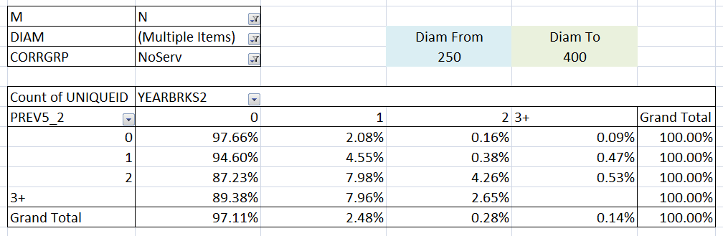
Predicting Break Odds
Probability of break for Thin-Wall CI, NoServ, 2 breaks:
= 7.98% X 1 + 4.26% X 2 + 0.53% X 3 = 18.09% breaks next year
Notes:
So, each of 40 years for those 8000-odd valve circuits became one row of a 330,000-row database table. In each row, were the variables we just went over: material, diameter and corrosion group; then the year, with the number of breaks in the previous five years, and the number of breaks the valve-circuit had THAT year.
This Excel Pivot Table lets us look at a summary of a part of that data table: just the record where the material group is “N” for “ThiN-wall CI”, it lumps together both diameter groups here, so I can get more stats, and for the corrosion group with NoServices.
So of all the mains where that is true, and had a year where in the last five years they had zero breaks, 97.66% of them had no break; 2.08% had one break, and only 0.16% of them had 2 breaks that year.
But that same risk-group, if you look at the ones where they had 3 or more breaks in the previous five years, had only an 89.38% chance of having zero breaks, and their odds of having one break had jumped to 7.96%, of having two breaks, leaped up to 2.65%, a 16-fold increase. At bottom, how these sum up to breaks per year: the chance of one break, plus 2 times the chance of two, 3 times the chance of three. You keep moving the pivot table through each cohort and add up the breaks per year expected for 0, 1, 2 and three breaks.

Slide 18
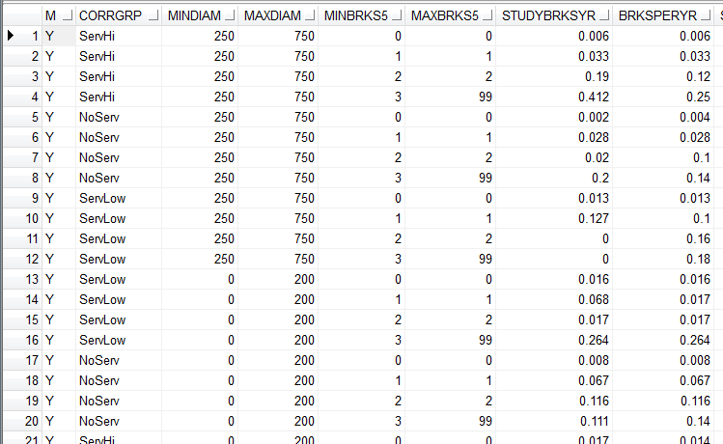
Expected Number of Breaks Next Year
probability of 1 break + probability of 2 breaks × 2 + probability of 3 or more breaks × 3
Notes:
After typing in all 100 or so, all the predictions are made by this table we call “BreakOdds”. Every single valve circuit in the system fits into one row of this table. Row 16 here, is for YDI material, Copper Services in Low Resistivity Corrosion Group, and 0-200mm diameter, and it’s had 3 or more breaks in the last five years. As a group, they will average 0.264 breaks each in the following year. The column “StudyBrksYr” is what came out of the pivot table on the last slide, using the formula at top. But we use the last “BreaksPerYear” column as that one was hand-tweaked if the probability from the study just didn’t match the breaks for the last dozen years.

Slide 19
Real World Testing
Verifying the Model Against Recent Reality
Notes:
With the probability table built, you can put the mains inventory for any year through it and compare to how that year really was. There were problems.

Slide 20
Can the Model Predict the Next Year?
Notes:
The above chart for the overall system from 1998 to 2011, and the original output of the model. As you can see, it ran consistently high – only touching the actual breaks for those dozen years in three spots. The problem, we suspect, is that we actually used too much data. Nearly half of those 40 years of records were for breaks on pipe now removed; they’re basically from a different system where more metallic pipe was in the worst soils. But the probability table is not carved in stone; the historical review simply gives you a starting point.

Slide 21
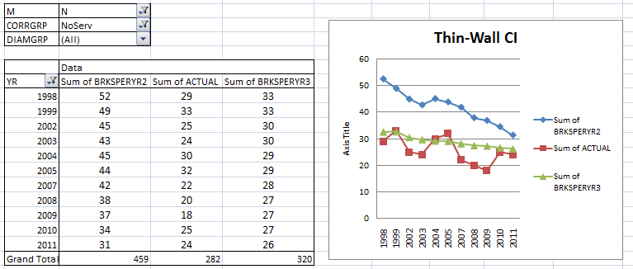
Tweaking the Model
Notes:
It wasn’t just that the overall numbers were a little high; the variances from current behaviour were concentrated in certain cohorts that had obviously changed the most over the decades from high replacement. Here, in red, the actual breaks for the previous dozen years on just the thin-wall, spun cast CI. In blue, the original predictions in the model. And in green, what the model produced after the half-dozen or so probabilities had been tweaked downwards. And to get the tweaking right, you can keep drilling down in the pivot table to find the ones most at variance – maybe most of the trouble is just from thin-wall, large-diameter, no-services thin-wall CI so you tweak that probability more.

Slide 22
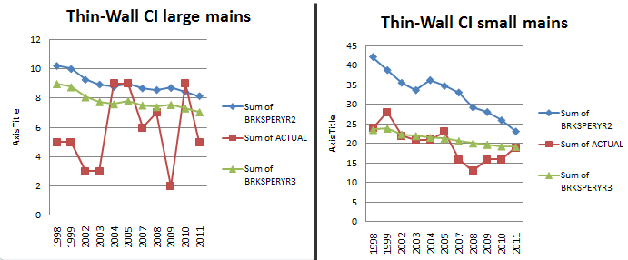
Tweaking the Model
Notes:
Here’s just one deeper level of breakdown. The actual breaks on large mains, at left, varied widely because there’s just a few breaks: so all probabilities were just tweaked a bit downwards to get the green line – being an unconservative engineer, you’d rather predict high than low when it’s uncertain. But on the smaller diameters, there was one probability number for low resistivity that was giving it really high numbers in the earlier years, though it became more accurate towards 2010; adjusting them lowered the prediction towards reality but especially lower in the earlier years. This was repeated for about a quarter of the table, a few dozen numbers. At the end, the model was predicting within 5% on all the years from 1998 to 2011, for each cohort.

Slide 23
Resulting Metric: Impact
Repair Cost: $25,000 each
TBL value on “house out of water” $100/person = $250
TBL value on “commercial service out” = $1000/service
1 Break on a Valve Circuit with 9 houses , 1 business:
$25,000 + 9 X $250 + $1000 = $28,250 consequence
Notes:
To determine the impact of the next break on a valve circuit, we put a cost of repairing each main break, plus a notional TBL cost for having each residential connection and commercial connection on that circuit out of water.
But the RISK, in dollars, is the $28,250 at bottom multiplied by that break-odds number the model calculates. That’s why it was needed: with this formula added, it automates the calculation of risk itself.

Slide 24
Resulting Metric: Yearly Risk
Yearly Risk = Break_Impact X break_odds
Yearly Risk Per Metre = Yearly_Risk / Length_of_VC
($25,000 + 9 X $250 + $1000) * 0.264 breaks/year 155m
= $48 / metre / year
Notes:
Once you have that probability of a break, and a TBL formula decided, the computer can calculate a separate TBL consequence cost for every valve circuit and that year’s break probability knowing only the past five year break count and the probability table. Divide by the length of the valve circuit and you have what every metre in the system will cost you, on average, the next year.
In the case of that YDI main cohort with 0.264 breaks per year expected per valve circuit, one that had the nine houses and a business and was 155 metres long would present you a risk of $48 per metre per year.

Slide 25
Resulting Metric
Risk, $/m/year | We Can Justify Money For:
$0 – $5 | Ignore
$5 – $10 | Monitor
$10 – $15 | Potential Anode Retrofit
$15 – $20 | Anode Retrofit
$20 – $30 | Potential Replacement
$30 + | Likely Replacement
Notes:
Keeping in mind that once you have reduced your risk number to dollars per metre per year, a computer can now flatly tell you which mains are worth spending capital on. If it costs $1100 per metre to replace, and you can borrow that for $33 per metre per year, then a risk of $33 per metre per year justifies replacement. Anode retrofit is more like $120/metre, but reduces breaks by only ¾ and has to be paid back in 20 years, so it starts around $10 per metre per year. Below that, we can only afford to watch.

Slide 26
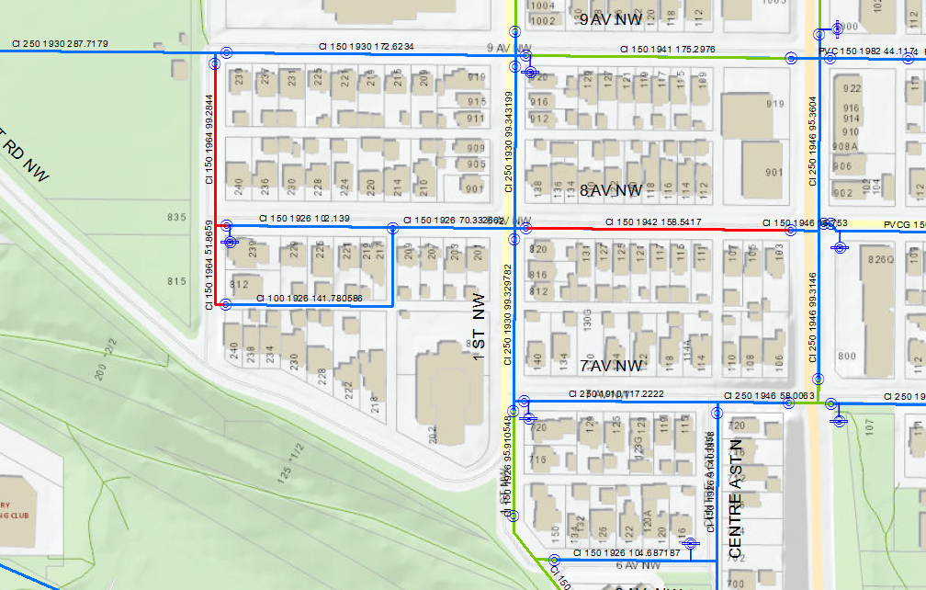
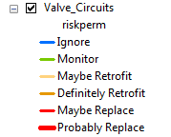
Risk and Recommendation
At a Glance
Notes:
So you can check the status of a main at a glance – is it coloured blue for “ignore” or red for replace? We can quickly respond to development issues.
And that was it. For two years we used that model as the basis picking our replacement and retrofit programs, checking condition and other quick queries.

Slide 27
2015 Model Review
Victims Of Our Own Success
Notes:
2015 was Roy’s last year, and we both went over it, step by step, so Joanna could take it over.

Slide 28
Why Reassess?
5 vs 7 Years Influence
Notes:
We needed to re-assess, not just for Joanna’s instruction and to double-check Roy, but because the breaks had continued downward, the system was still a slightly-changed inventory every year.
One thing we double-checked was whether it improved anything to use the last 7 years of breaks as the driving factor rather than 5. The entire valve-circuit-years list was done with that count the second time.
The extended period of influence only dampened the odds for additional breaks, leading to a lower expected future break rate of the system.
You can see that the seven year line, in green, hugs the lower end of the actual breaks. It wasn’t that it was any less accurate, it just wasn’t any more accurate – and the difference was in a less-conservative direction. So we decided to keep the five-year limit on history as it was enough, and it was a little less conservative.

Slide 29
What Do We Use It For?
Initial Replacement or Retrofit Program Selection
Quick Assessments:
Answers for Residents, Councilors
Opportunities to Extend or Reduce Jobs
Notes:
Besides using the coloured map to shop for replacement and retrofit jobs, it’s great for quick assessments when we get called about the infrastructure health around some new proposed development: they get an answer in minutes most of the time. And it helps with job-planning as you can note that another high-risk valve circuit is near a job you’re doing and it can be more cheaply added in.

Slide 30
Future Refinements
Figuring out why initial numbers were high
Effects of Services and Soil Resistivity
Important Buildings on a Valve Circuit
Do All Breaks Affect the Main the Same?
Notes:
A future run of the model will have to experiment with not looking at the whole last 40 years, so that you don’t have to tweak the probabilities at the end. Secondly, when the probabilities were figured, there wasn’t really a big difference between high and low resistivity soils in this usage. They are very useful when looking manually at an individual main and deciding which of two mains, both with two breaks, to replace; but when you sum up 20 resistivities on a block and reduce the whole block down to “high” or “low”, it didn’t’ have much predictive value. Coppers services may remain in the model, but all these assumptions need testing.
Our TBL valuations will be more customized over time. At present, the computer is just counting the number of services turned off; with GIS and time we can add TBL value for schools and skyscrapers. And one piece of data never used were our careful records of each breaks as being circular, a split, a hole, and so on. Perhaps circular breaks are far more predictive than holes – or vice-versa. Since we’ve had significant success just with a first attempt, it’s an area open for a lot more work.

Slide 31
Thank you for your time!
Any further questions please contact
Joanna Line, joanna.line@calgary.ca
Roy Brander, roy.brander@gmail.com

