Slide 1
Ten Years of Water Utility Asset Management
Roy Brander, P.Eng.
Senior Infrastructure Engineer
City of Calgary Water Resources
Notes:
Good morning, I'm Roy Brander, the Senior Infrastructure Engineer for Water Resources, City of Calgary. I've been doing Asset Management for them for longer than 10 years: first it was AM/FM, that's Automated Mapping and Facilities Management from 92-97, then we called it Infrastructure Engineering until about 2002. The ten years is just how long we’ve CALLED it Asset Management.

Slide 2
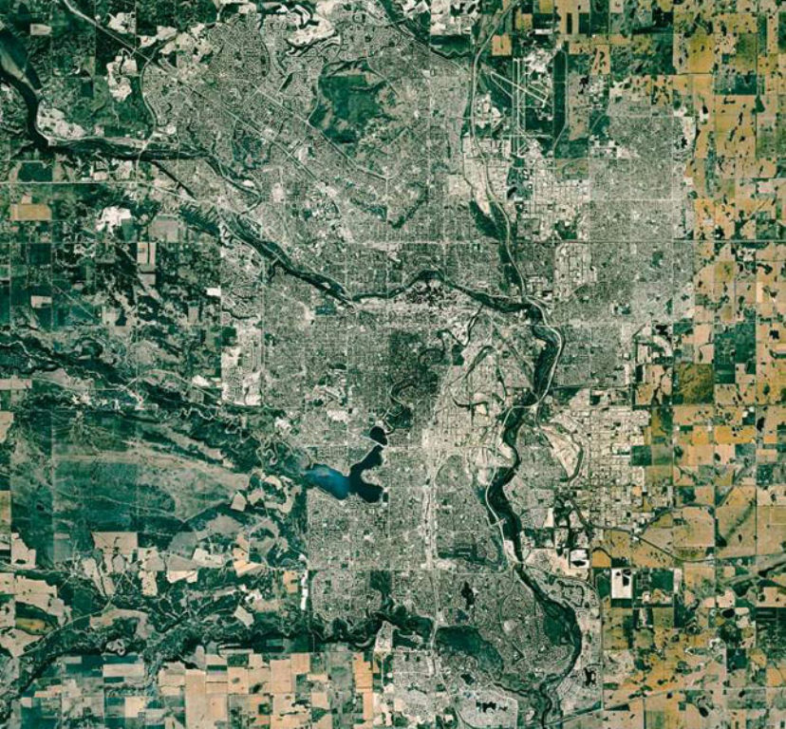
Calgary
650 sq. km.
Population:
1.1 million
Metro Pop:
1.2 million
A “Uni-City”
Notes:
Calgary is now a city of 1.1M people in the foothills of the Rockies at the chilly elevation of over a thousand metres, semi-arid with less than 350mm of precipitation in a year. What's different about Calgary from most North American cities is that the whole metro area is only about 1.2M - it is what city planners call a "Uni-City", not a group of connected municipalities. It's created quite a large system all under one management.

Slide 3
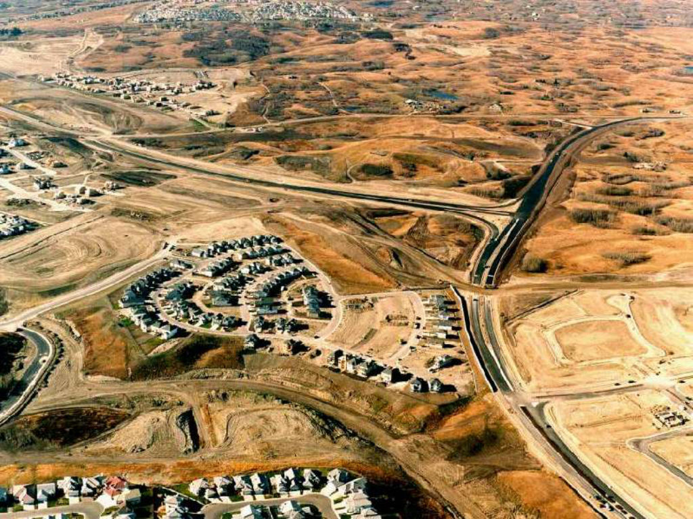
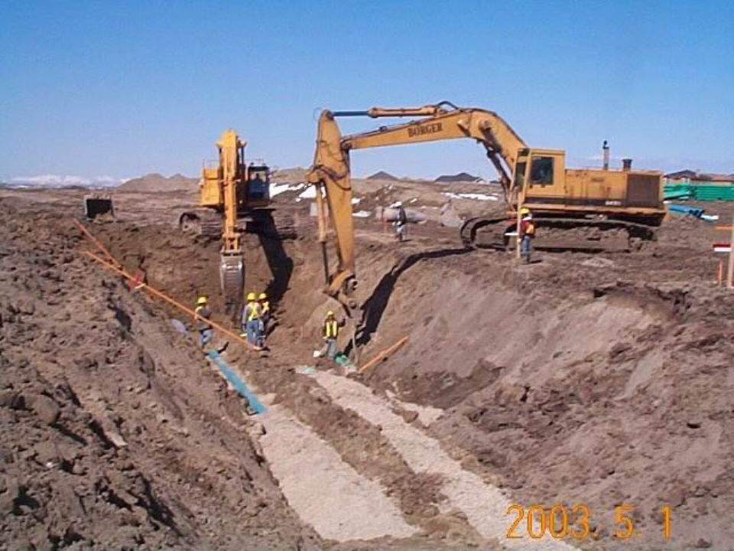
Notes:
It’s growing larger every day. This photograph could have been taken anywhere on any edge of the city since World War II. In every direction, the new subdivisions are going in constantly, the developers digging the triple trench - water, sanitary and storm – three expensive metres deep to get below the frost line of the high prairie, for an average of 100km of new streets and pipes and wires every year.

Slide 4
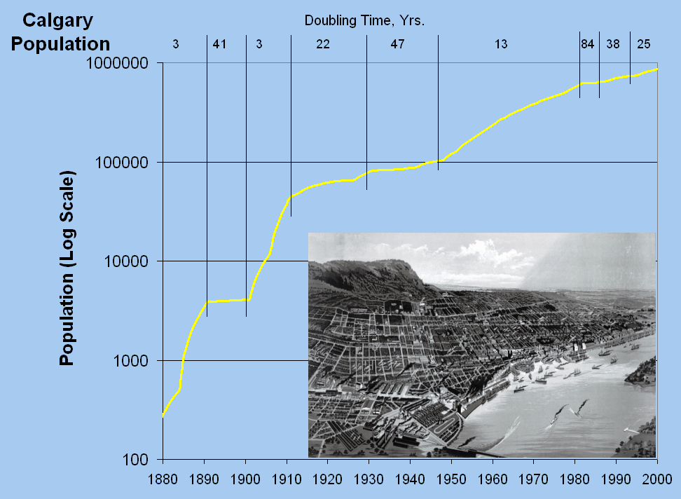
Notes:
That 2% growth rate is one of the highest in North America, so fast that for engineers I always use a log-scale to show our population. The numbers across the top give the slope of the log graph as a doubling time. In the 40 years from the end of the war to the mid-80's, it doubled three times, from 100,000 to 800,000. It has leveled off only a little since. The picture in the lower right is Montreal in 1880.

Slide 5
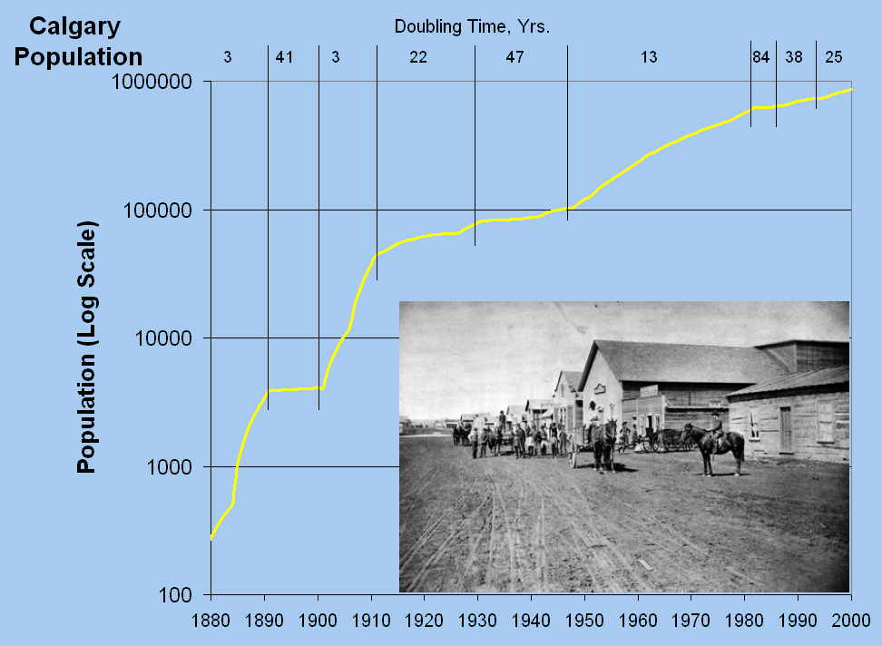
Notes:
And that one is Calgary in 1880. Not a picture taken in Calgary, that's the whole city, except for the tents. So we’re basically a 20th century city, built for the car. And it's a well-recorded city; we don't have accurate records of infrastructure from before about 1916, but in our case, that's nearly everything.

Slide 6
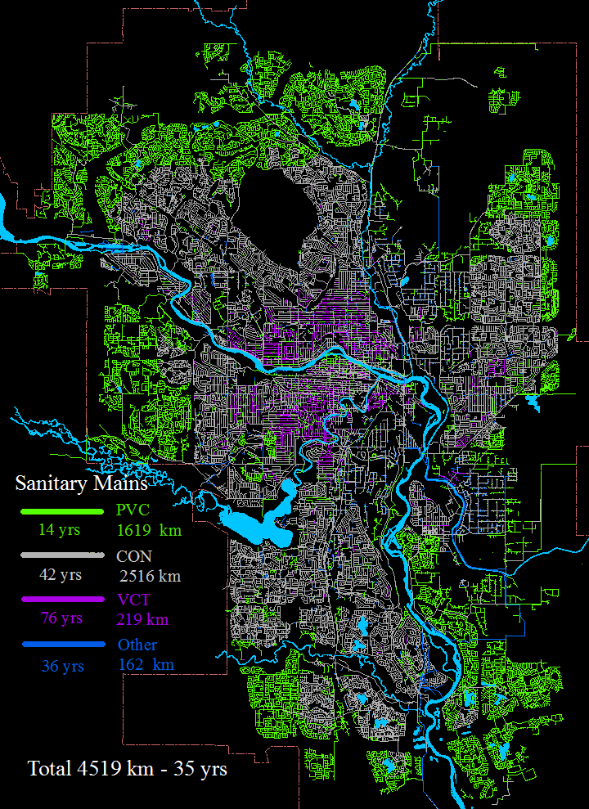
Notes:
Trees have growth rings, and so do cities, as seen by infrastructure records. For our sanitary system, the oldest ring, in purple, is VCT, vitreous clay tile, which means the same stuff as dinner plates – non-corrodable but brittle - its average age is 76 and you can see how it clusters around the two rivers, where Ft. Calgary started at the confluence of the Bow and Elbow. Then there’s the concrete growth ring, average age 42, and the green PVC growth ring since 1980.

Slide 7
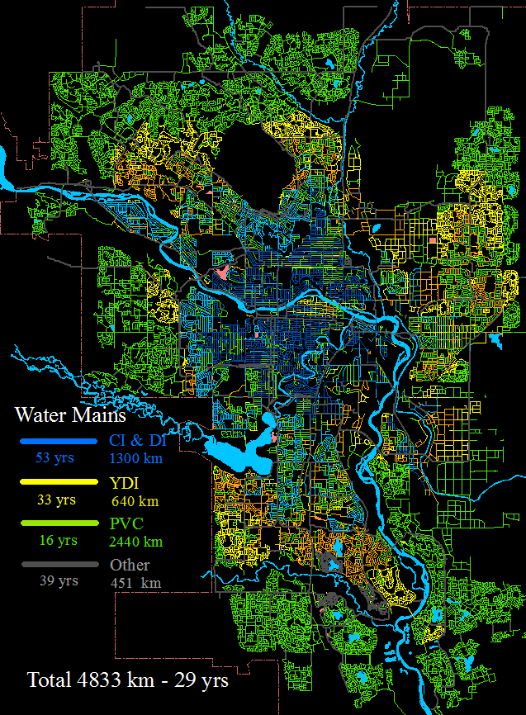
Notes:
It's our water system that really shows the growth rings because we’ve tried so many materials: the dark blue is thick-wall cast iron used from 1900 to 1954, the light blue thin-wall cast iron from 54-68, then ductile iron in orange from 63 through the 70s. The yellow is a variant we call YDI, yellow-jacketed ductile iron, which is DI with a corrosion protection of plastic covering and anodes. Lastly, the PVC, of which we now have a higher percentage than any city outside of Asia - over half the system is plastic. Throughout the older areas, you see the sprinklings of green where we have replaced over half the pipe that is older than myself, born in 1958 when Calgary was just over a quarter of its current size.

Slide 8
Notes:
That leaves only about an eighth of our system as older than the Prime Minister or myself. The rest is so young, you can date it by pop-culture celebrities: one-third is younger than Justin Bieber; another third is younger than Nelly Furtado. So while we're a large city, we have the infrastructure problems of one half our size. Alas, our Council knows that, and budgets accordingly. So for AM purposes, consider us a city of half a million.

Slide 9
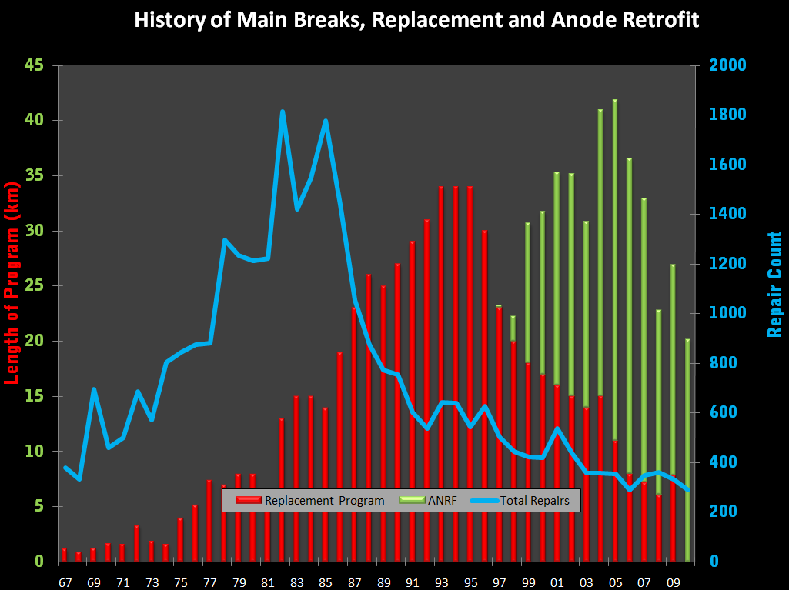
Notes:
The blue line on this chart is measured against the right-hand axis – it’s the count of total repairs on those water mains since 1967. The red bars are against the left axis, the size of our main replacement program in kilometres per year. I called those parts of the chart “Old Faithful” because I would start every presentation with it to explain how I got my job. The skyrocketing repairs – over 1800 in 1978, with several repair crews working day and night in the winter – forced us to ramp up a huge main replacement program in the 80’s and 90’s up to a peak of 35 km/year in 1992-1995, which brought the break-rate down into the 600s. Then they started cutting the program, but realized they had no idea how far down they could cut it to reach a steady state, rather than another increase in the breaks. For that matter, nobody had any idea what the optimal break plus replacement costs would be, where the sum of the two would be minimized. I might have eventually found that number, but a new technology shown in green, changed my equations.
Anode Retrofit was being rapidly adopted in many cities. With anode retrofit, you don’t dig up the whole street, you just drill a hole down to the main every ten metres or so, and attach a magnesium anode that stops the iron from corroding. It costs only 10% as much as replacement, per kilometre, and yet drops the break-count by over 80%. Only a little of our main is so far gone that anodes can’t save it, and that’s the remaining red in recent years – just 5 to 10 km/year. The combined cost of replacement and retrofit has dropped by millions per year, yet the breaks have been cut in half again from 1995 – from the 600s down to barely 300 per year, saving another several million dollars per year. That will hold true another ten years, until we run out of main suitable for retrofitting. If you want some attention from your management, there’s nothing like handing them tens of millions in savings.

Slide 10
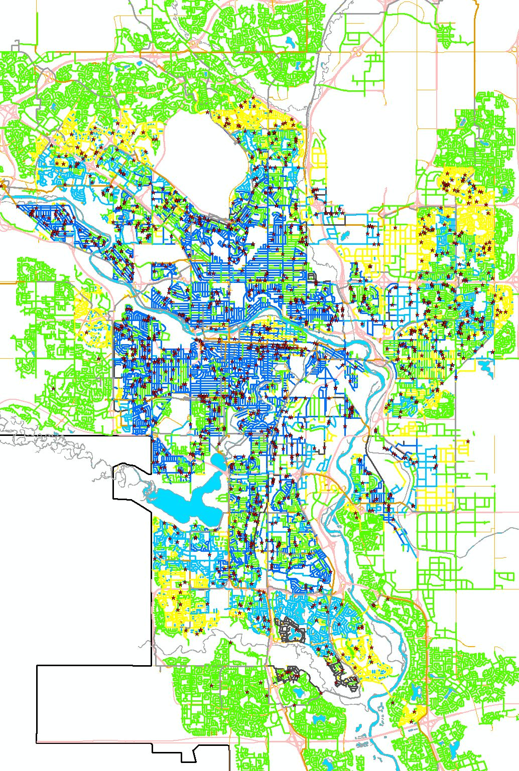
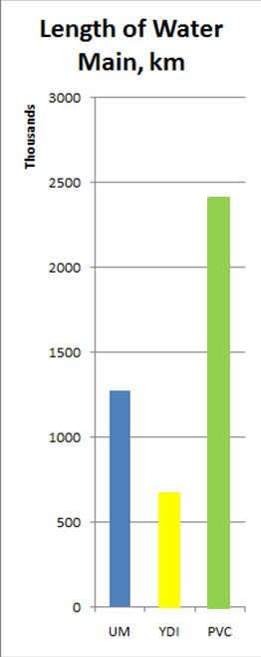
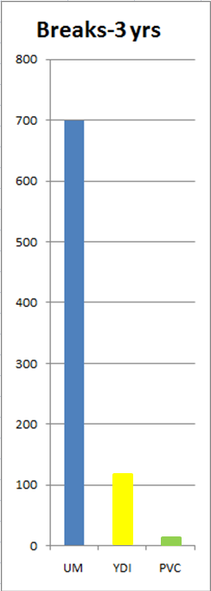
Notes:
The huge value of corrosion protection is highlighted by the analysis of where our breaks happened, the map at right showing the last 3 years of main breaks as red dots – you can see how few happen to the green PVC. The graphs highlight that while over half our main is PVC, it gets less than 1% the breaks of the blue, the unprotected metallic. The corrosion-protected YDI main gets only 10% the breaks of unprotected. “An ounce of prevention is worth a pound of cure”.

Slide 11
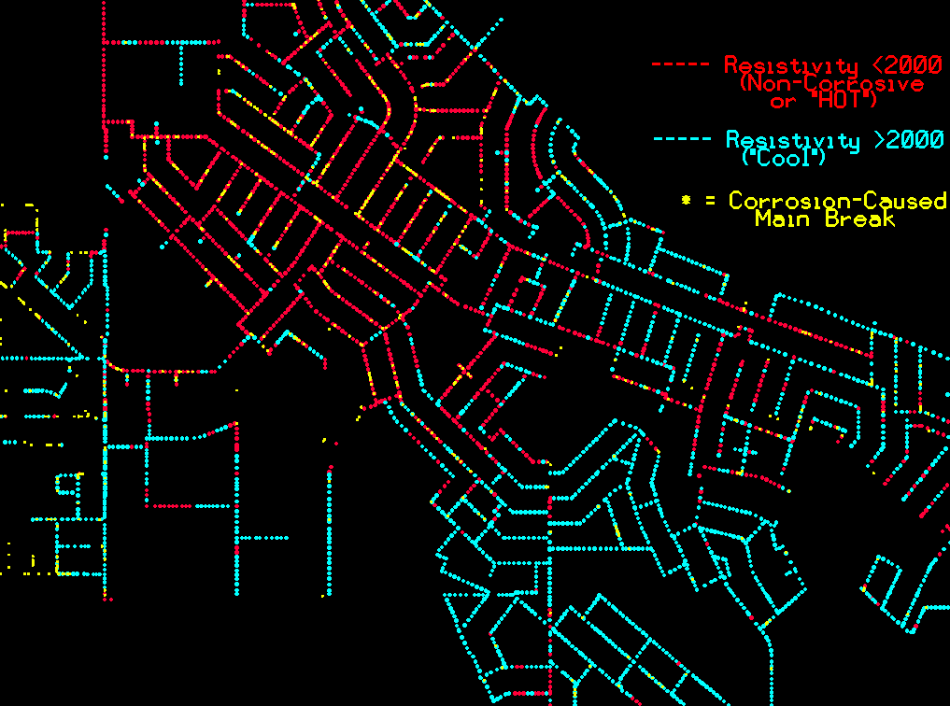
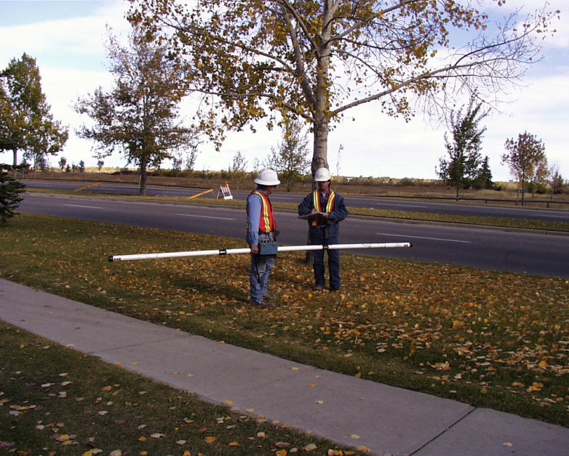
Notes:
GIS is my favourite tool for making sense of AM data. The Geonics soil resisitivity meters, at lower left, gives you at a button-press the resistance of the soil below to electrical current, key to its corrosiveness. The Geonics project gave us over 100,000 soil corrosiveness data points, in front of every house served by metallic main, for the price of a couple of blocks of replacement.
Even the most simplistic soil resistivity map – with “cool”, less corrosive soils in blue and “hotter” corrosive ones in red, with the main breaks in yellow, show how soil resistivities can help predict break probability. Where you have two mains of the same age and number of breaks – one is more likely to have the next break than another if it’s in bad soil. An ounce of added data can be worth two pounds of cure.

Slide 12
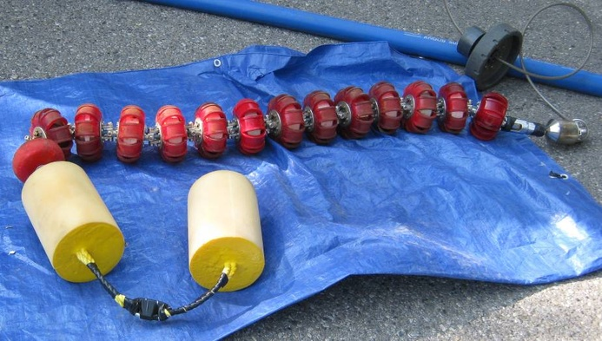
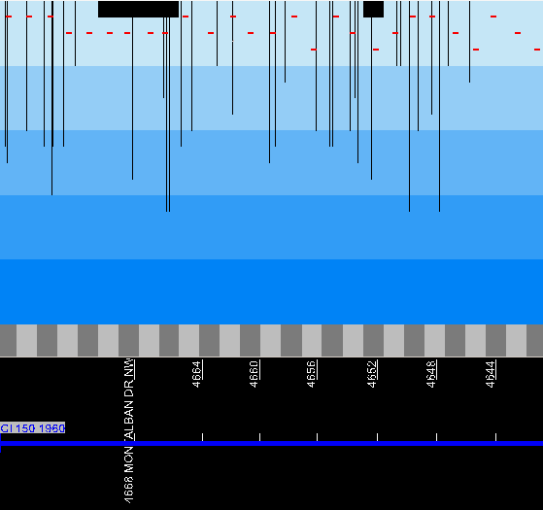
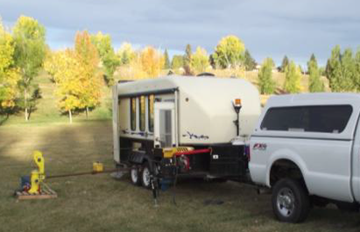
Electromagnetic Inspection of Mains
Using Russell
Technologies’
HydroScope ™
(now SeeSnake ™)
Exact pit depths and locations of holes
Notes:
For the toughest calls, we developed electromagnetic inspection of some mains. What is now called the “SeeSnake” is a collection of round disks full of wound coil antennas that put out a signal that travels through air better than metal, and analyses the return signal along the several discs to show where all the pits and holes are in the pipe wall. It can be fed into the system through a hydrant and flushed through the mains by water pressure, giving you data without the expense of a dig. The graph at lower left shows the main on my street at bottom, the alternating grey bars are the separate pipe-lengths, and the black shafts at top show the pit depths from the outside wall through the 20%, 40% and 60% wall-penetrations. We could see the main on my street had no pits more than 60% of the way through, after fifty years. We knew it would go another 25 before the first break, and at twelve years, my block still hasn’t had one. The main was otherwise indistinguishable from the 700m of main through the rest of my neighbourhood that we spent a half-million replacing. So that $20,000 SeeSnake run saved $200,000 on my block.

Slide 13
Calgary Waterworks / Calgary Sewer Division Merger
Reorganized into
Water Resources: Planning, Development, AM, Construction Management, Water Quality & Regulation
Water Services : Plants, Linear System Operation, Construction Services
Touted as “Asset Management Focused Organization”
Started $10M “Enterprise Asset Management System” project
Notes:
The water mains project had all these programs – SeeSnake, Anode Retrofit, soil testing – down to a routine and a huge monetary success by 2003, when Calgary Waterworks and the guys down the hall in the Sewer Division were decided to be better off merged, and it was some years of hard reorganization and trauma to make that happen. The two were not just merged, but completely reorganized into two groups – Water Resources is basically our engineering functions, Water Services people operate and maintain the systems. My own group was not just tasked with doing for sewer mains the equivalent of what we’d done for water mains – part of the reorg stated that we would become an “Asset Management-Focused Organization”. That is, our part of Water Resources would act as the “asset owner” and the Services side as the “asset maintainer”, separating who decides how much work is needed from those who make a living doing the work, hopefully eliminating a conflict-of-interest. I was put on the first project to make that more than a phrase: a $10M IT project to eliminate some 30 small IT systems various areas used to manage their work with a single IT product called an “Enterprise Asset Management System”.

Slide 14
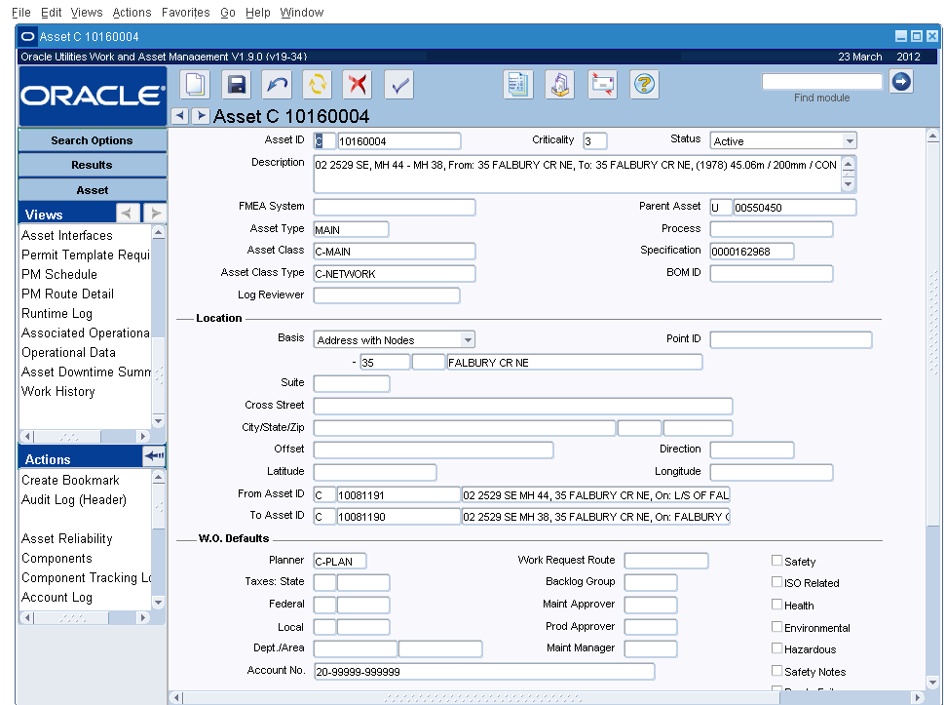
Notes:
We did not get one, for the very good reason that, in my professional opinion, there are no “Enterprise Asset Management Systems” that are worthy the name, on the market, in 2004 or 2012. What we got was a single generic database that would hold any asset of any type, and a work-management system. It was called Synergen, which was soon bought by a larger company, SPL, that was in turn purchased by Oracle, so the name recently has been OWAM – Oracle Work and Asset Management. This is one of its screens for a single asset, number 10160004 – a sanitary main for one block. Ours currently holds 1.9 million assets, which required a lot of expensive custom interfaces to load in from our old systems, since the product itself only comes with the ability to type them in by hand.

Slide 15
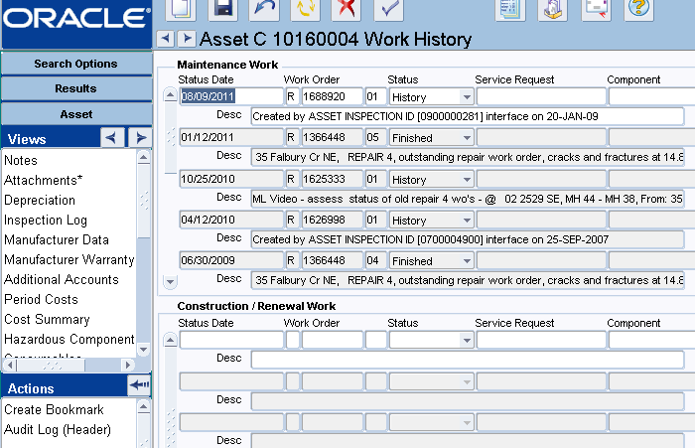
Notes:
The OWAM system handles the creation, progress-tracking, and, eventually, even the timesheets and costs of all work orders applied to assets, and so you can, as with this screen, look up the work-order history of any asset. Besides the basic asset attributes like age and material type, the most valuable asset-management information is the work done on it – how many times has it failed or had to be repaired.

Slide 16
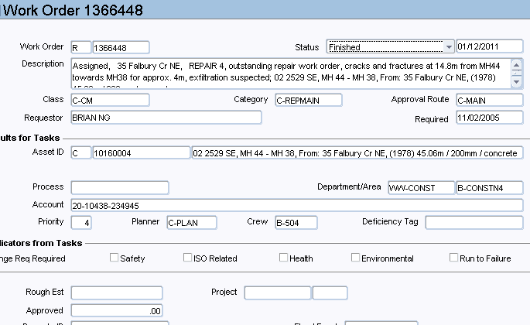
Oracle WAM Individual Work Order Record
Notes:
Clicking on one of those work orders brings up the full work-order record, which is as detailed as people take the time to enter – which of course means not very detailed most of the time. This one is for a dig-repair on that sewer main to repair cracks and fractures.

Slide 17
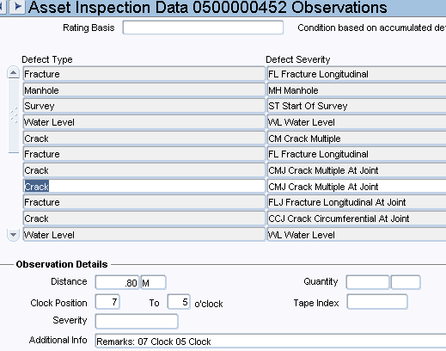
WAM stores Asset Inspections – 30,000 video runs, 900,000 defects
We were able to “back create” work orders and inspections going back to 1991.
Single repository of all assets, all work, all inspections.
Notes:
With another click on the view menu at the left of every screen, you can jump to the inspection log for an asset if it has some form of inspections. This one contains the notes from a video inspection of that sewer main, showing four entries for “crack” and two for “fracture”.
So the system does have ways to hold all the data, though the very generic, one-shape-fits-all data structures can make it awkward to access. But I said it was not really an Asset Management system because it has no functionality to process that data – no way to put in calculations that would allow the sum of work records and inspection records and asset attributes to indicate the need or priority for rehabilitation or replacement. You have a single column for criticality and another for priority – but they must be hand-entered. So we don’t. This system is instead used as raw data to feed computations in a data warehouse where we are free to add new columns and run calculations that let us choose assets for rehab or replacement.

Slide 18
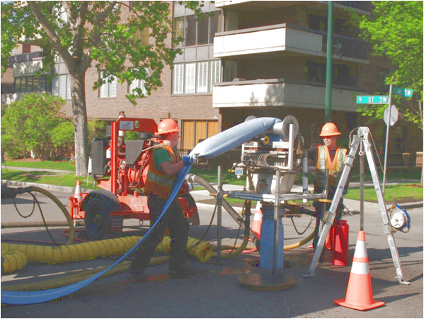
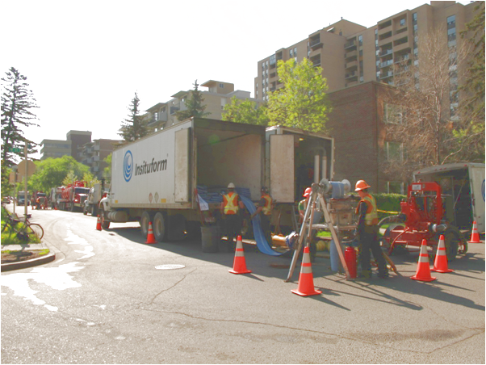
Sanitary Sewer Lining Program
RFP won by Insituform
Now reaching thirty kilometres per year
One-tenth the cost of replacement
Notes:
And the need for choosing sewer mains in particular for a capital treatment suddenly grew ten-fold. We were a little late, compared to some other cities like Edmonton, at the new technologies for sewer main lining. It had a startling resemblance, if only in finances and strategy, to the introduction of anode retrofit for water mains: it adds 25 to 50 years to the life of a failing main, and it costs only one-tenth as much as replacement. We had a big enough backlog that the first year’s selections were pretty obvious – but then we had to pick out some 30 kilometres, over 300 mains, per year, for lining. And it was a complex selection because that low cost depended heavily on clustering the jobs geographically so that you got a lot of mains lined for one setup of several trucks. There was no way to do it with the supposed EAM system, which had only the slowest and most awkward links to our GIS.

Slide 19
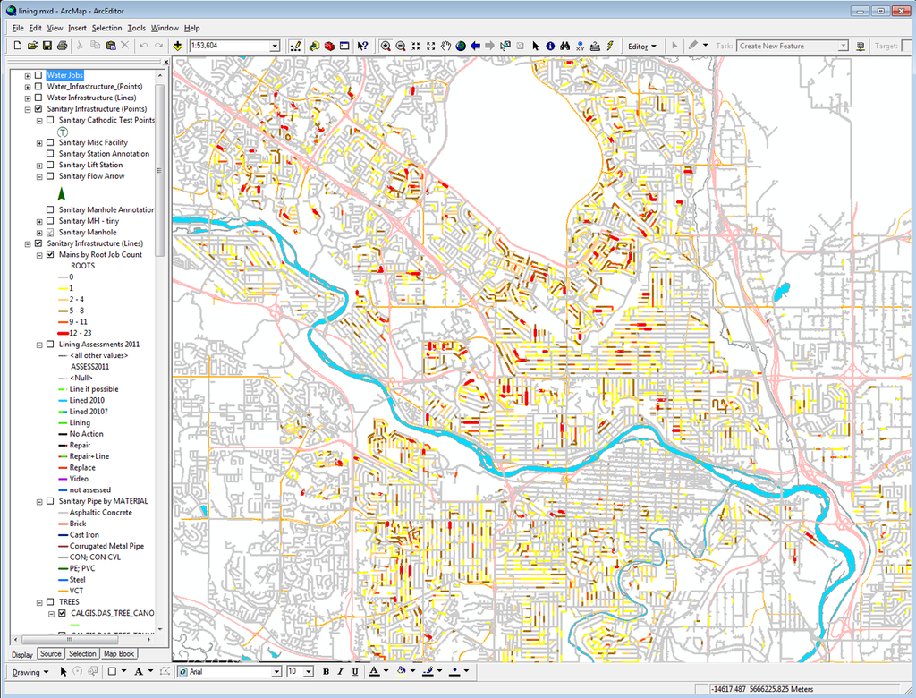
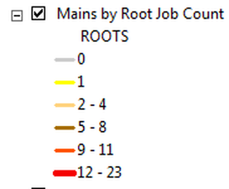
GIS Showing Sanitary
Mains by Count of Previous Root-Cleaning Jobs
Notes:
So I devised a lot of SQL queries that take nearly an hour to run each night, and suck virtually all of the data about both sets of mains, their work, and their inspections, into a simpler structure in a data warehouse-type database that does connect to our GIS. Now I could show things with GIS maps like the number of repairs, or in this case, root-cleaning jobs, that had been done to a main. Once again, this makes an impossible cloud of data leap into coherence as you see that almost all of this map is grey for having zero root-cleaning jobs done on the main. And the places where there have been five and ten and more such jobs, shown in orange and red, are geographically clustered, mostly where we have poplar trees. Lining is good for various defects in mains, but it is best for eliminating the leakage that attracts roots down into the main, so these orange and red areas will be our top priority for years to come.

Slide 20
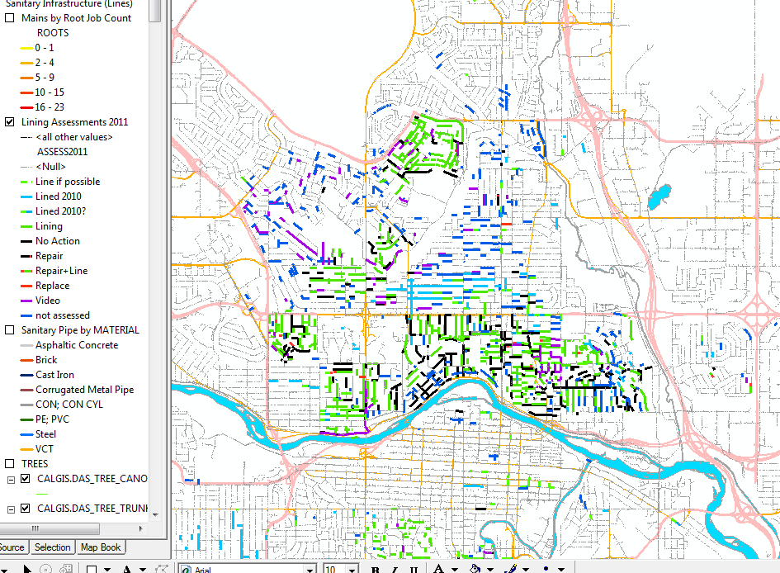
GIS App for San. Lining Program Selection
Notes:
We assemble our preliminary choices for work in this data-warehouse, too. They only become OWAM work orders when we in AM hand them over to construction engineers to get done. This map shows the lining selections in green, the already-lined in blue, the leave-alone mains in black.

Slide 21
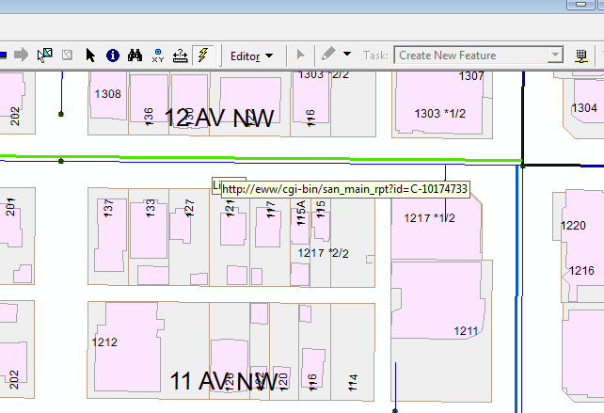
ESRI Trick: Any GIS feature can be a web hypertext link
Notes:
But with a built-in ESRI GIS trick that lets you put a web URL in the database for every asset…

Slide 22
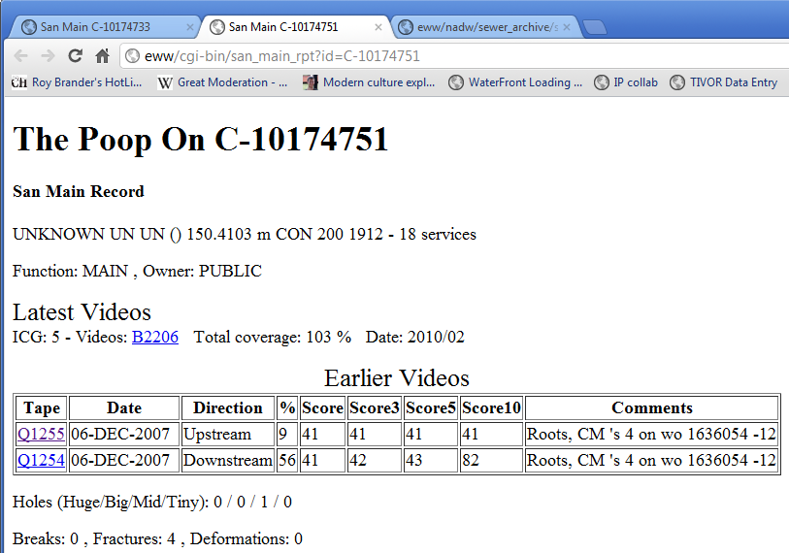
But the link can be to a Web App that gets a full report from the Data Warehouse
Notes:
and jump to a web page for that asset, we did a small web app that gives you everything the data warehouse has on that main, from it’s basic attributes and the videos done on it….

Slide 23
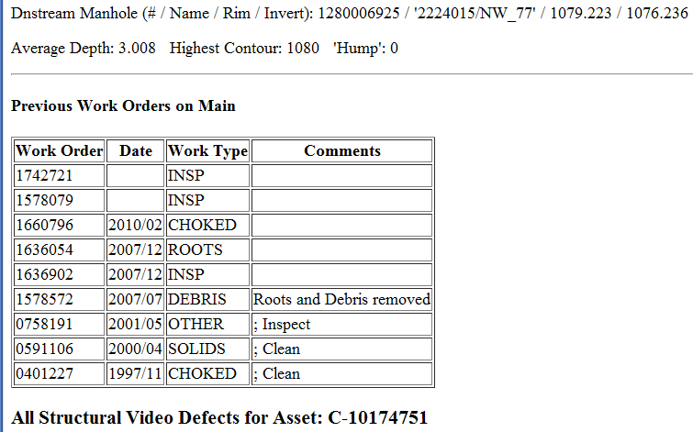
Scrolling down – all work orders in the Data Warehouse made from OWAM
Notes:
to the whole work history, every work order done on it….

Slide 24
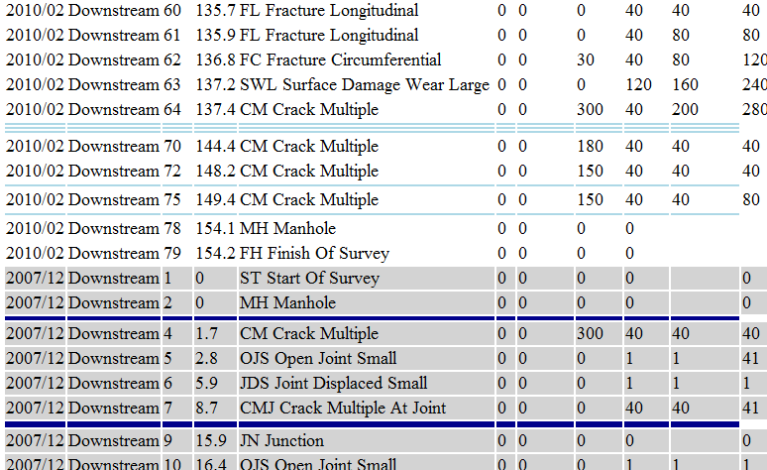
Further down – every defect found in those two videos
Notes:
…and every single defect found in all those videos. With a fast computer and well-indexed tables in the data warehouse, several retrievals from WAM that took many minutes become just a few seconds for the whole web page.

Slide 25
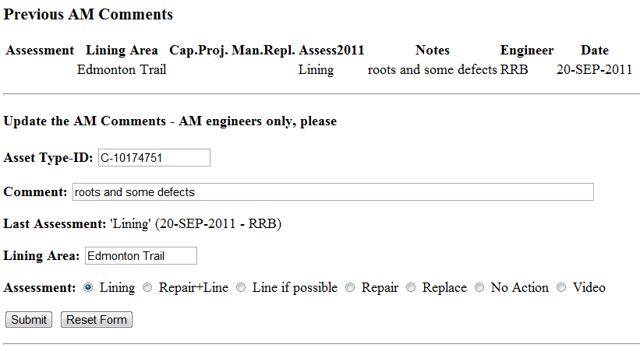
Bottom of Web Page: Form for AM Evaluation
Notes:
and then the bottom of that page is a web form that shows you any AM decisions so far, and lets you pick what to do with the main from a menu and submit it to the data warehouse.

Slide 26
GIS App for San. Lining Program Selection
Notes:
Back on the GIS, the main goes from grey-for-unreviewed to green for “line it”, immediately, and you can work your way through a whole neighbourhood in a day. For me, a real asset management system first lets you discard 90% of your data with a few flexible, easily changed calculations, like the last slide highlighting the root jobs; the other part makes it quick and easy to review everything about an asset and select a treatment for it in a few minutes each, like this system. I’m not sure when such a full-featured AM system will come on the market; for the moment, I’d advise a healthy budget of both time and money for rolling your own. The RIVA product is one that Calgary is working with in that regard.

Slide 27
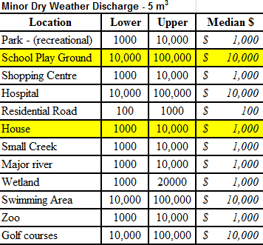
Triple-Bottom Line Exercise from Hunter Water Australia, 2006
Financial: $12,000 to repair (real dollars)
Environmental: $10,000 (would pay to avoid)
Social: $ 1,000 (would pay to avoid)
Total TBL Cost of Failure: $23,000
Probability of Failure per year, based on AM’s model of what characteristics (material, age, history) are associated with past failures:
1% per year
Amount worth spending per year to avoid failure: 0.01 X $23,000 = $230
$230 Per Year becomes this one main’s “budget” for inspections (videos), planned maintenance, and mitigation efforts (ready spare parts, tools for containing spills).
Notes:
We wanted to move not just to asset management for the underground linear systems, to true Enterprise-wide Asset Management, and that required a single, consistent model for everything. We hired Jim Keary and Peter Buckland from Hunter Water Australia to advise us about “triple-bottom-line” calculations: valuing not just money, but hard-to-monetize values like environmental damage and social disruption. In 2006, we spent two weeks with them going over that same familiar ground of wastewater mains using TBL.
Their approach was to encourage a diverse group around a boardroom table to reach agreement on the order-of-magnitude alone. That gives a starting point from which you can go on to develop a decision, and whether the decision passes the laugh test either confirms the assumption or helps you to refine it with citizen engagement. At right, we have part of the table of values we developed over a few days: backing up sewage into a house basement, in the $1000 to $10,000 order-of-magnitude. For a schoolyard, $10,000 to $100,000. If using the lower-end of those values does not develop a large enough replacement or rehab program budget to match numbers that have been approved previously by the political level, repeat.
Here, for one main, it served houses, and was also close to a schoolyard, so we added up the $10,000 and $1000 to $13,000 in notional TBL costs – what we would pay for a magic wand that would make those consequences not happen. Then the actual $12,000 repair costs is added in. Multiply by the probability of it happening to this main, based on whatever condition-assessment model you develop with the data you have, like the material, age, and work history, and you have the budget.

Slide 28
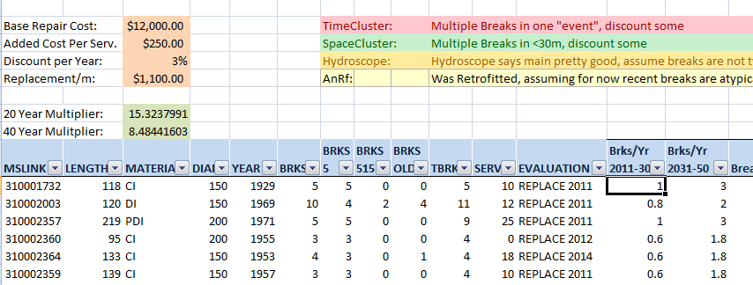
TBL Cost-Benefit Applied to Each Water Main Replacement Candidate
Notes:
I applied a simplified approach to that for a recent water-main selection, and it gave useful results that let us cut the program by about 20% to make a budget target. It was a very wide spreadsheet, so the top half of this slide is the left columns, the bottom, to their right. I went with a very simplified probability of main-break prediction for the next 40 years if it is not replaced. Using the breaks that happened over the last 5, 10, 15 years, I extrapolated a slightly higher break rate for the next 20 years, then a higher again for the 20 after that. Each break is assigned a repair cost of $12,000, and a TBL cost of $250 for every house out of water times the count of services on that main – that figure based on $100 per person per day out of water as a social value. Then all those 40 years of break costs are given a net-present-value, and if it exceeds the cost of replacement, it went on the program. The results matched our previous system fairly well, and helped us decide which ones to cut.

Slide 29
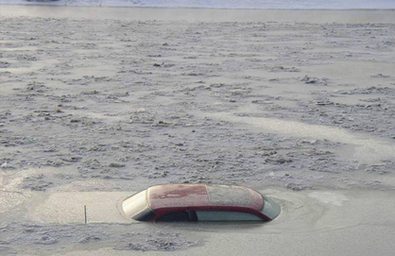
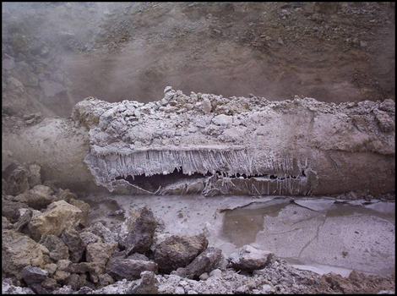
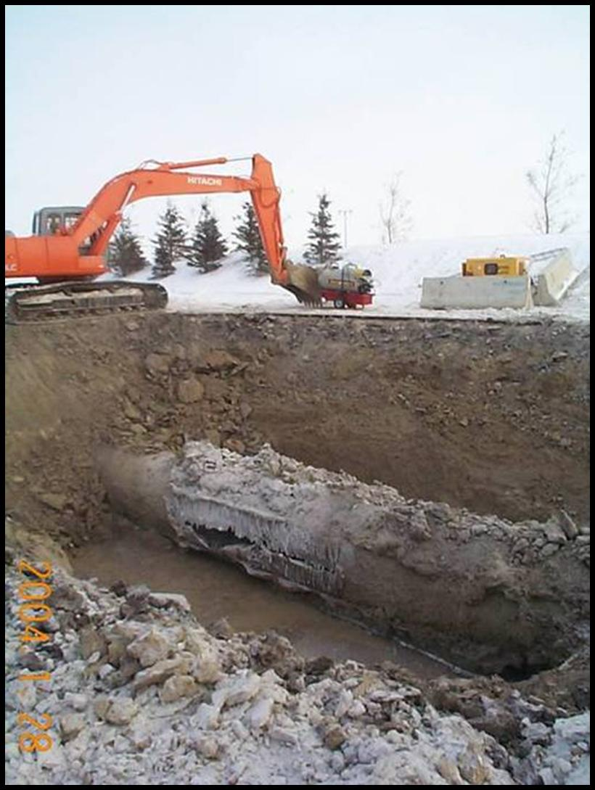
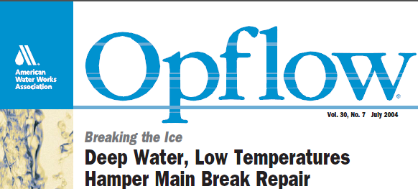
Mcknight Blvd. 1200mm Water Main Break at -35C
Notes:
The TBL cost-benefit approach helped us both strategically – setting the size of a new budget we’d never had before – and tactically – deciding where and how to spend that budget – to respond to a real major-news-story emergency that hit us hard on the coldest week in a decade, January 2004. A 1200mm main broke near a major thoroughfare, catastrophically, filling the whole area with water. You can see how the one car near the intersection on a Sunday morning fared. If it had been Monday, we might have lost lives. The repair costs was millions in dollars and months of poor pressure to a tenth of the city. We made the cover of “Opflow” magazine, but not in a good way. And we’d never even considered the possibility of major feedermain breaks, never had one like it. We frankly had no idea how to avoid another, and everybody was looking at the just-named AM group.

Slide 30
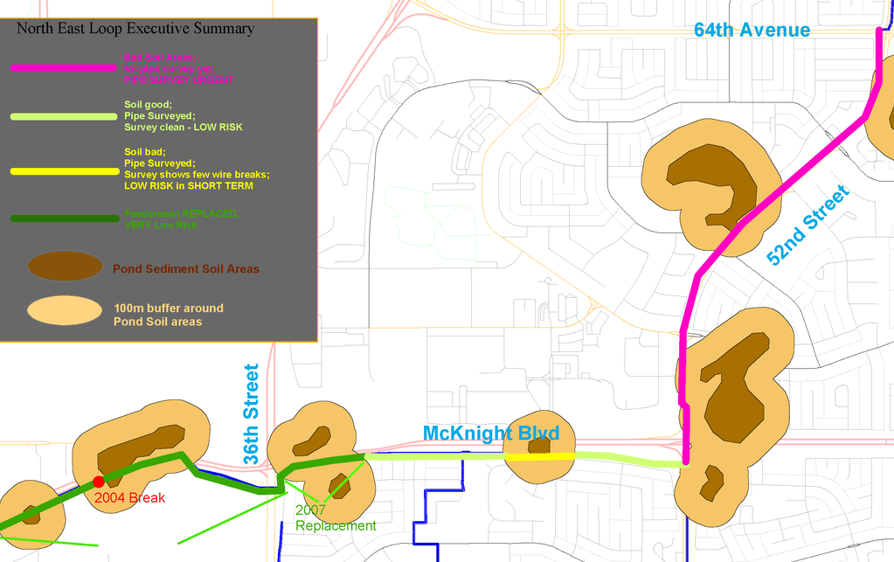
Solutions Justified by Risk Analysis for Water Feedermains:
Soil Sampling for Sulfates – $1M/yr Inspections – Spare Parts
Inspection Technologies:
Electromagnetic For Wire Breaks in CON
Leak Detection with Microphones, Fibre-Optic, “Smart Ball”
Still Experimenting
Notes:
After we found that McKnight had been corroded by high-sulfate soil that ate even the concrete cover on its reinforcing wires, we could start a first-blush response just from our GIS maps. The dark brown polygons are from our GIS layer for soil types, showing old ponds with black, sulfate-laden, corrosive soils, and the beige rings around them are 100m buffers done by the GIS for a lower risk factor. The McKnight main is shown here in different colours for its risk level. The 2004 break is at lower-left, just at the edge of an old slough. The GIS can then add up the kilometres of large mains that pass through the brown and beige areas. We tried out, on that main, various new inspection technologies rather like the SeeSnake. Calgary is hugely lucky in having Pure Technologies based there, who inspect oil and water pipelines around the world. The concrete mains are held together with reinforcing wires, so electromagnetic inspection tools are very helpful. Where we have surveyed with them, we can put probability-of-failure figures based on the number of broken reinforcing wires. Where we haven’t at least we can come to some order-of-magnitude using the soil it’s in.

Slide 31
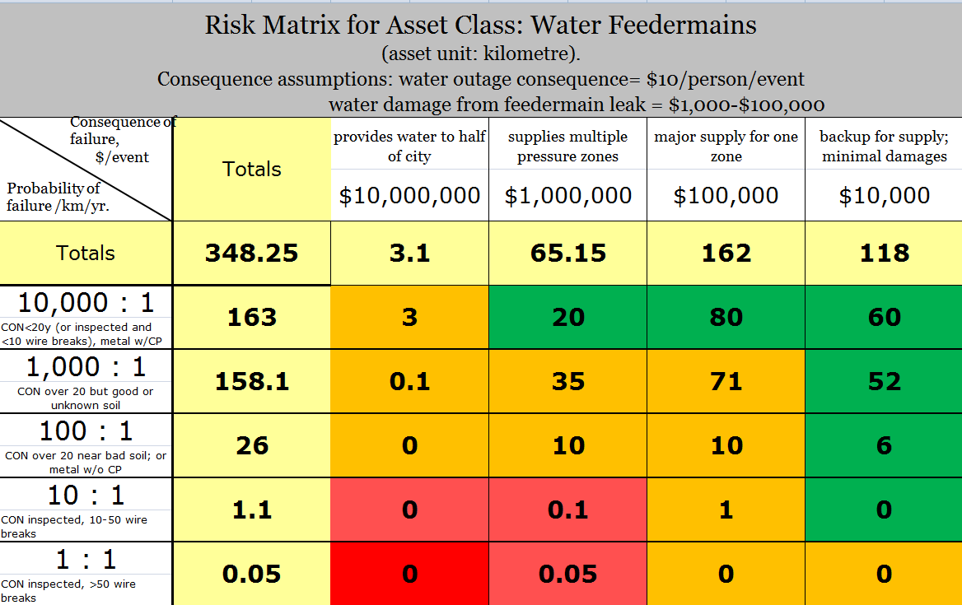
A Risk Matrix that Uses DOLLARS for Risk,
not just “High Medium Low”
Notes:
If you’ve done any asset management, you’ve seen these risk matrices, but usually without any hard numbers to them – just the chance of failure as High-Medium-Low and the consequence of failure the same. To make the complete lack of actual information look nicer, they always colour the matrix in traffic light colours like this. My own contribution was to marry Jim Keary’s “just get the order of magnitude first” advice with the matrix. Based on the number of kilometres we’d had last the decades we’d had with no breaks so far, I figured probability of failures on healthy concrete feedermain was one in10,000 per kilometre per year. And that the McKnight failure had lasted nearly ten years with fairly bad corrosion of its reinforcing wires, so that failure probability was one in ten. Then the corrosion level it finally reached was, well, 100% per year. Interpolation gave us the two orders of magnitude in the middle, based on the main’s age and surrounding soil. Our already-developed TBL values on the consequence of failure were used for the valuations on different mains with different criticalities. The $10/person/day is for water at low pressure, our usual consequence for feedermains being out – a order of magnitude less than actual water loss from the last example. The rest was a matter of surveying mains for their criticality, and checking the soil maps.

Slide 32
Notes:
The same TBL model holds at small and large scales. On this spreadsheet, it sets separate risk-per-year dollar figures for individual reaches of feedermain. The material type and soil give you the chance per year of a failure, the number of customers affected, a cost per failure. Multiply together and you get the budget worth spending for inspection and failure prevention on each main.

Slide 33
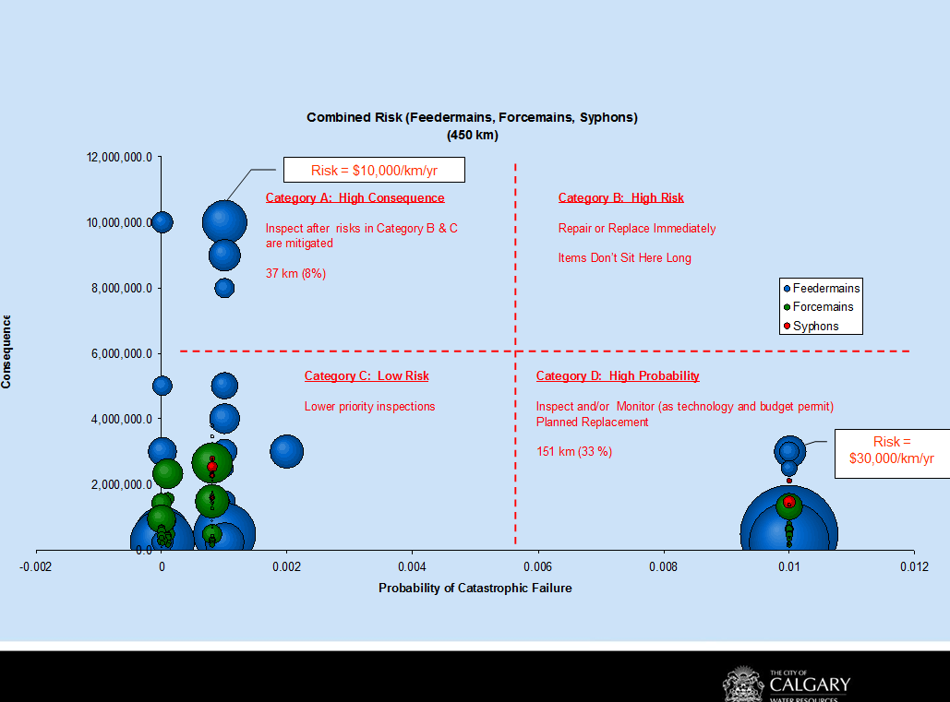
Notes:
After doing the GIS run on all 300 km of feedermains, and working with the network planning people to assign criticalities to most of them, we showed the full three-dimensional result with a bubble chart, one bubble per reach of main, the bubble size proportional to its length. The x-axis is the probability of failure, the Y-axis is the TBL cost of the failure. So it’s just a graph version of that risk matrix. For our director’s consumption, we then simplified that down to four quadrants. The upper-right quadrant, where failure is both likely and costly, must be empty. The lower right, where you have the amount of main that has high probability but tolerable costs, is your planned maintenance and replacement area. The upper left, where failure is critical but unlikely, is where you put heavy inspection and testing regimes. And the lower left, you should see most of your assets in, as that’s the area you can afford to ignore. Adding up the risk for all our large mains gave us a million-dollar-per-year budget to spend on those upper-left and lower-right quadrants, and a business case for getting that budget, which has now totaled $7 million since 2005, allowing us to inspect and find two locations where we proactively replaced before they could break. And now we have badly corroded mains to show off that never became catastrophes, to prove that business case was merited.

Slide 34
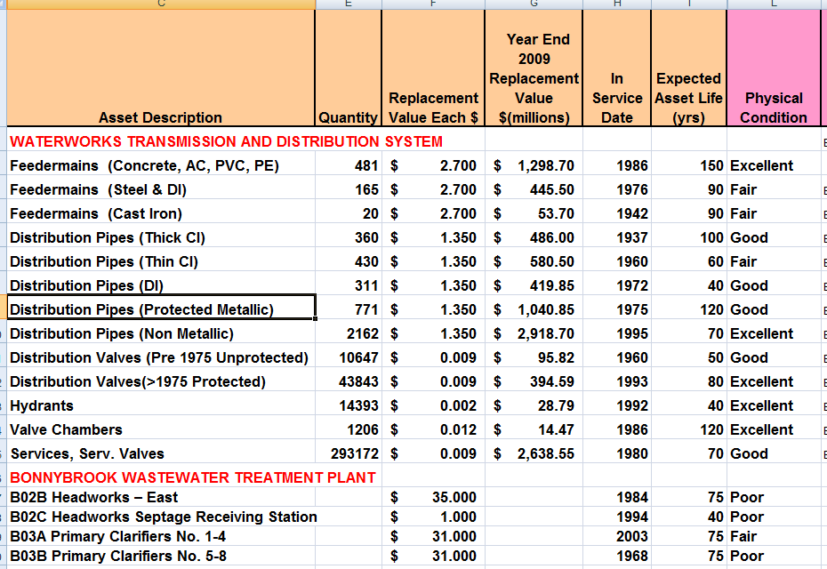
Infrastructure Status Report – “prep” for TCA
Notes:
We are just now bringing this analysis to all assets comprehensively as a due-diligence exercise for both City Council, and increasingly, the federal government. For us, the Tangible Capital Assets requirement was sequel to an initiative by our City Council to have an Infrastructure Status Report that covered every asset whether we were concerned about it or not. Here’s the first page from the early version of the status report – it doesn’t report on every asset individually, but on every asset class – and you can see my concerns that different materials types of water mains were whole different asset classes. I’ve pushed together separate parts of the report – the water distribution system and part of the one Wastewater Treatment plant, to emphasize that the overall report covered every asset. I added up a replacement value of $33 Billion.

Slide 35
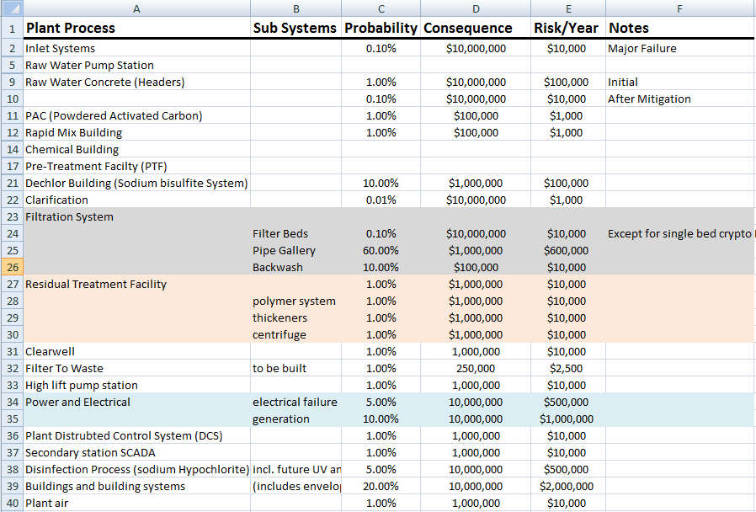
TBL Order-of-Magnitude Risk Analysis Won Over the Plant Staff
Notes:
It was just last year that we finally took our show on the road out to the treatment plants, where we were met with some concerns that we were just pipe guys who didn’t know their systems or their problems, but were going to presume to judge their risks and budgets. I explained the whole order-of-magnitude approach to them and got them to understand the basic formula of multiplying probability by consequence to get dollars-per-year of budget to replace, repair, inspect, and mitigate. Once they understood we were merely there to facilitate them explaining their budget needs with hard figures rather than scare stories, they jumped on-side in about an hour flat, and we’d estimated risk for a whole treatment plant in about four hours. Yes, the numbers were rough, but our directors were concerned, after McKnight that we weren’t looking at failures that were unlikely, but very high consequence, so this was a start at comprehensive review of all assets. The plant staff were able to communicate all their concerns to the top with dollar figures, not just arm-waving.

Slide 36
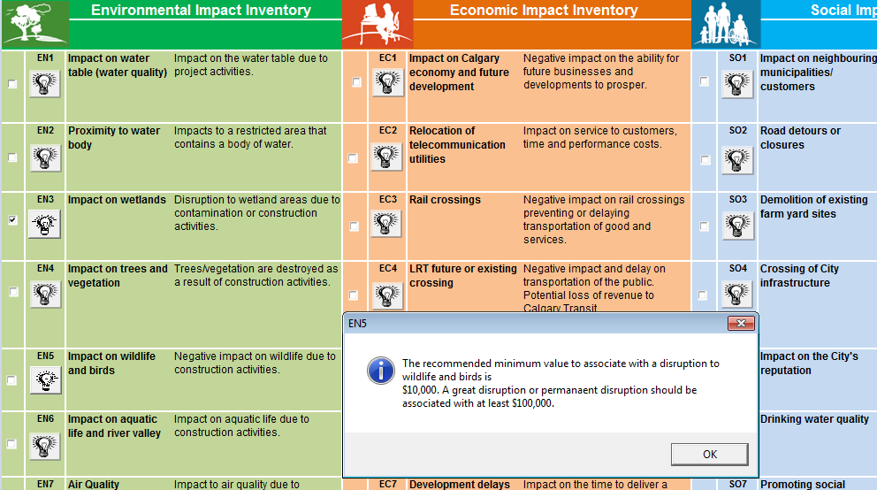
Business Cases “TBL” Valuation was Standardized
Spreadsheet where you just checked off impacts
Notes:
As part of a new initiative to have a business case for every one of 230+ line items in our $300M capital budget, we decided to include a utility-wide consistent TBL valuation system. There are some dozens of possible impacts for each of environmental, economic, and social impacts. Before you check one off, you can bring up the description and suggested order-of-magnitude. In the case shown, disrupting bird and wildlife habitats down by our rivers is pegged at $10,000 to $100,000 per disruption, giving a lot of latitude to adjust individual cases – and the database allows us to compare all of them quickly, see what the reason each project had for going to one end of that scale or the other, allowing us to quickly push them all towards consistent valuation of intangibles.

Slide 37
Summary
Asset Management is just Cost/Benefit Analysis
Balances Operating vs. Capital Solutions by using NPV calculations
Includes Triple-Bottom-Line DOLLAR valuations of poor service, environmental and social damages
Applies a CONSISTENT set of rules to all assets and to all work areas
Notes:
And with that, we come to Calgary’s state of the art so far. The principles we’ve applied, as you can see, are just Asset Management 101, basically – cost-benefit comparison of the NPV of future failures vs. capital cost of replacement or rehabilitation. That’s combined with the Hunter Water Australia system of dollar valuations on all TBLs, and shortcutting the enormous job of setting those dollars by just getting agreement on order-of-magnitude to get a starting point from which to refine. Across three very large systems with very different problems in pipes and plants, we’ve found this model has worked for us, and we’re set up for the very long haul of applying it in greater detail to thirty-three billion dollars we’ve been entrusted with.

